Slide 1
Introduction to Hardware

Slide 2
What is binary?
We use the decimal (base 10) number system
Binary is the base 2 number system
Ten different numbers are used in base 10. How many are used in base 2?

Slide 3
Bits & Bytes
kilo, mega, and giga are different in binary!
bit (b) – a binary digit
KiloBit (Kb) – 2¹⁰ bits
MegaBit (Mb) – 2²⁰ bits
GigaBit (Gb) – 2³⁰ bits
Byte (B) – 8 binary digits
KiloByte (KB) – 2¹⁰ bytes
MegaByte (MB) – 2²⁰ bytes
GigaByte (GB) – 2³⁰ bytes
TeraByte (TB) – 2⁴⁰ bytes
PetaByte (PB) – 2⁵⁰ bytes
http://en.wikipedia.org/wiki/Binary_prefixes

Slide 4
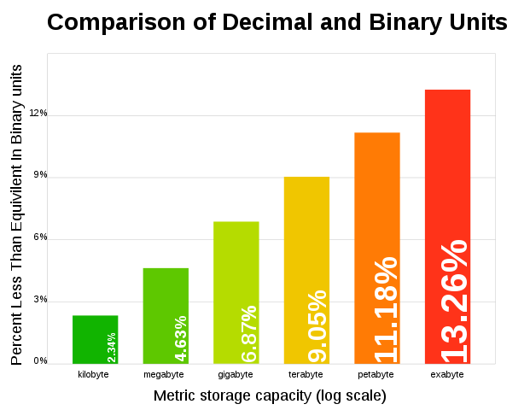
Storage Scam!
Example: iPad 16GB
How much space are you *actually* getting?

Slide 5
Input Devices
Keyboard
Mouse
Webcam
Sensors
…any others?
Notes:
http://www.leapmotion.com
http://www.youtube.com/watch?v=_d6KuiuteIA

Slide 6
Output Devices
Monitor
Printer
Speakers
Actuators
Motors
any others?
Notes:
Oculus Rift - http://www.youtube.com/watch?v=KBylGcvRuek

Slide 7
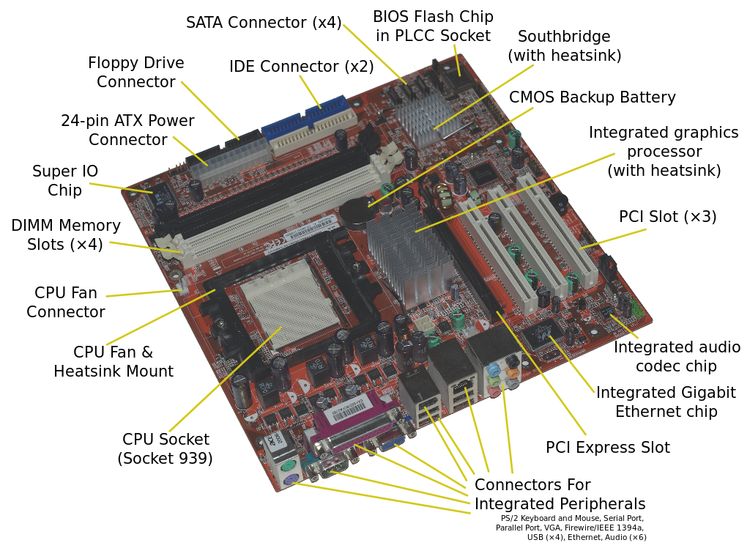
Motherboard
Connects EVERYTHING!

Slide 8
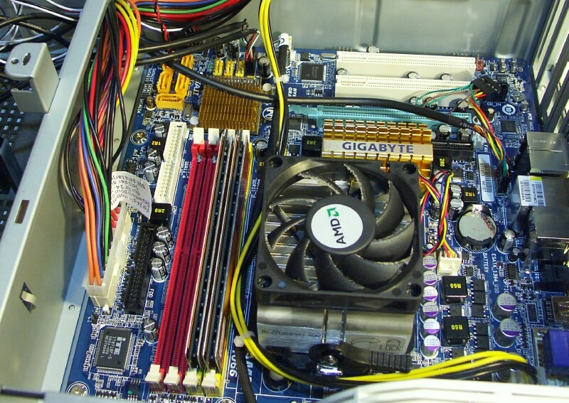
Motherboard cont’d

Slide 9
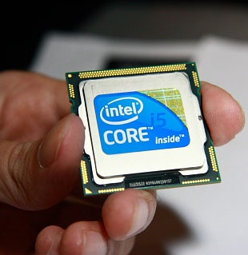
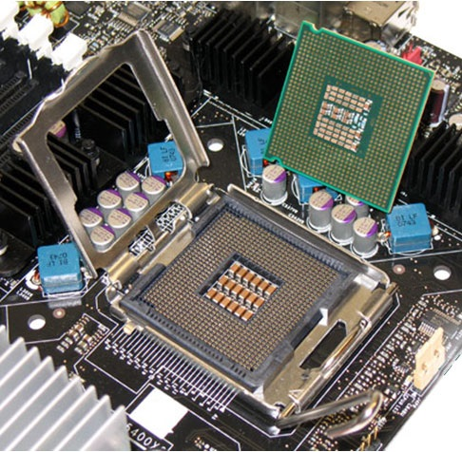
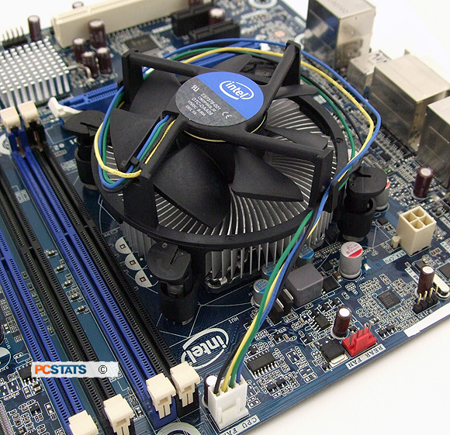
Central Processing Unit (CPU)
Computer’s thinking/calculating brain part
Pay attention to:
  Model (e.g. Intel Core i5)
  Clock speed (e.g. 2 GHz)
  Socket type (e.g. LGA 1156) ← changes from year to year

Slide 10
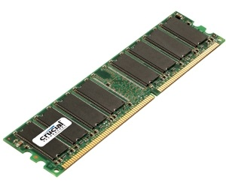
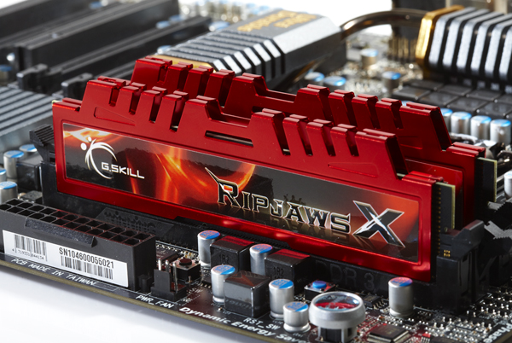
Random Access Memory (RAM)
Computer’s memory part of the brain
Pay attention to:
  Brand (e.g. Crucial, Corsair, Kingston, G. SKILL)
  Size (e.g. 2GB)
  Specification & Speed (e.g. DDR3 1333 MHz)

Slide 11
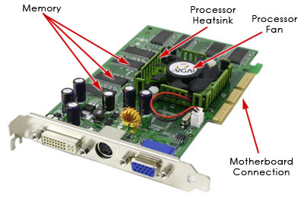
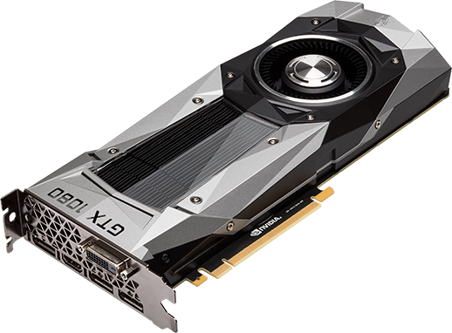
Graphics (Video) Card
Specializes in displaying graphics
Pay attention to:
  Brand (NVIDIA, ATI)
  Size (512 GB)
  Speed

Slide 12
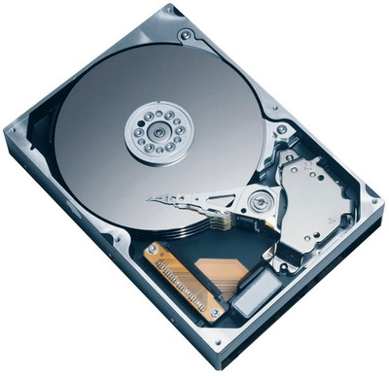
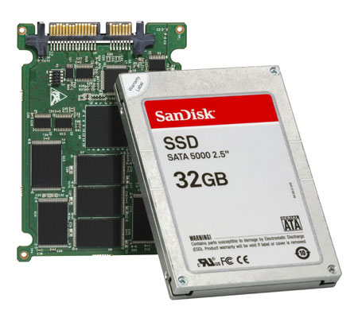
Hard Drive
Stores everything
Pay attention to:
  Brands (Western Digital, Seagate)
  Speed (e.g. 7200 RPMs)
  Size (e.g. 512 GB, 1TB)
Optional:
  Solid State Drives

Slide 13
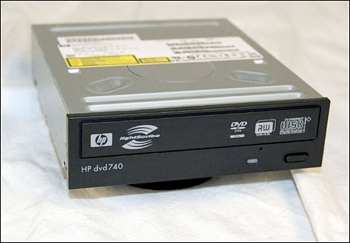
CD/DVD
Pay attention to what it can burn…
Note: This is an example of a dying technology

Slide 14
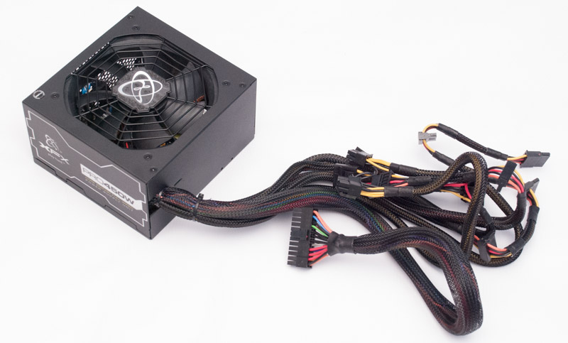
Power Supply
Connects computer to electricity
Different cables go to different components
Power Supply Calculator

Slide 15
Laptops, Smartphones, Tablets, etc.
All of the above are comprised of the same major components
Only differences:
  Sizing
  Packaging
  Operating systems (software)

Slide 16
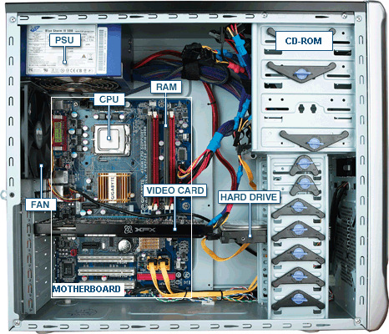
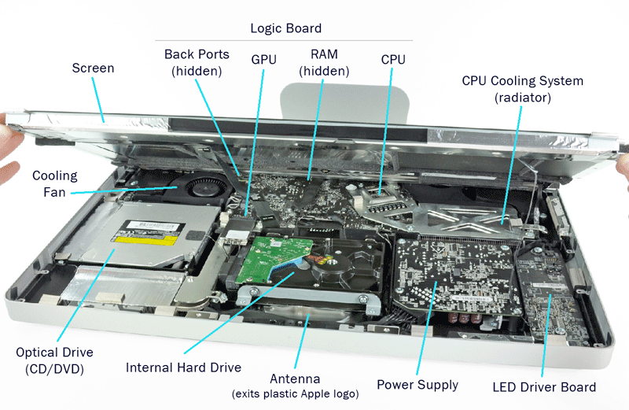
Desktop Examples

Slide 17
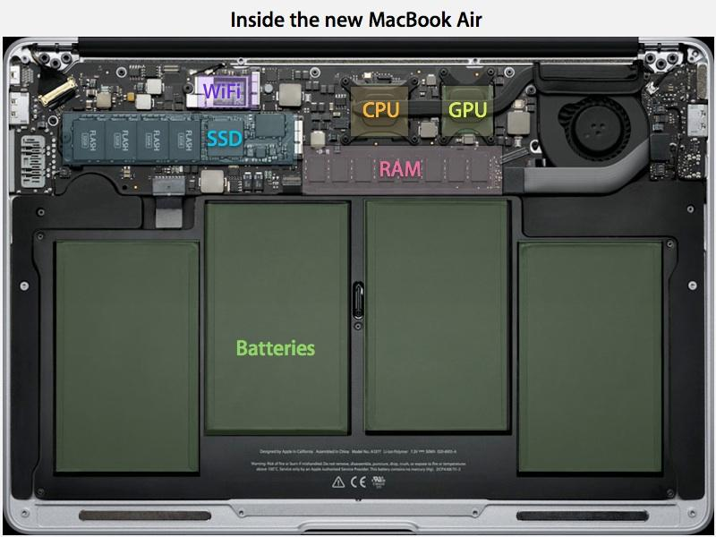
Laptop Example

Slide 18
Build Your Own PC
Website that lets you pick parts:
  www.pcpartpicker.com
Websites where you buy parts:
  www.newegg.com
  www.amazon.com
  www.microcenter.com
FAQs
  http://www.reddit.com/r/buildapc/faq

