Slide 1
Networks – Network Fundamentals

Slide 2
How do computers connect to each other?
Wired vs. Wireless
Network cards
Special device on computer that lets the computer connect to a network
Can be wired or wireless
Switches
Centralized device connecting multiple computers
Routers
Forwards (routes) packets of data to the appropriate destination

Slide 3
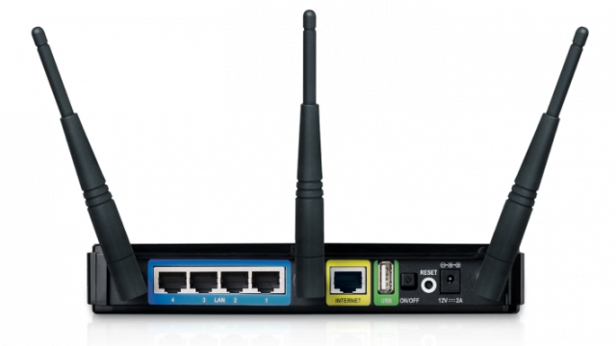
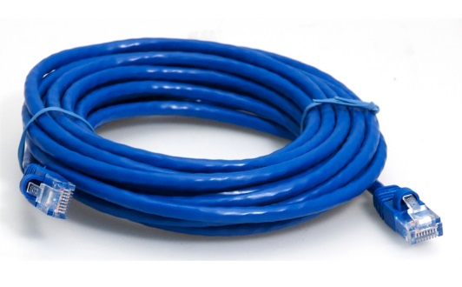
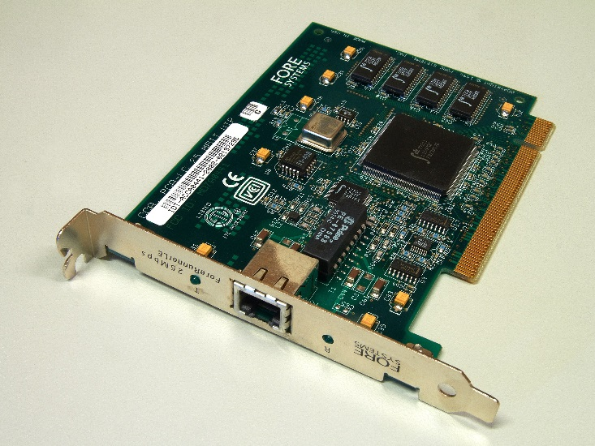
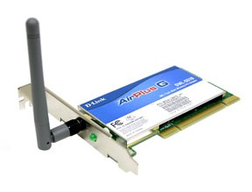
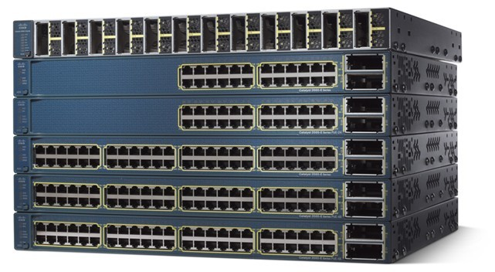
Network Hardware

Slide 4
Standards & Protocols
Standard – a common language
Standards enable compatibility through a common “language” internationally
Protocol - agreed set of rules (how to do something)
Why are these important?

Slide 5
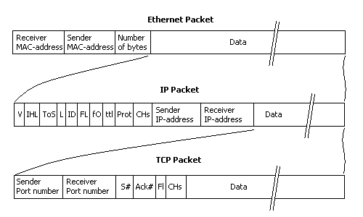
Data Packets
envelope of data sent between computers
typically contains:
source (origin) address
destination address
sequence numbers (for packets that combine into one larger piece of data)
timestamp (i.e. postmark)

Slide 6
Network Layers
Network communication broken up into layers
Each layer worries about something specific
Open Systems Interconnection (OSI) model
Layer 7: Application (e.g. web browser)
Layer 6: Presentation
Layer 5: Session
Layer 4: Transport
Layer 3: Network
Layer 2: Data link
Layer 1: Physical (e.g. network cable)

Slide 7
Local Area Network (LAN)
Computers connected together in a geographically local area
Examples:
A computer lab
Your home’s network

Slide 8
Virtual Local Area Network (VLAN)
Computers grouped together or mutually isolated to mimic a LAN, but are not geographically local
They do not have to be connected all to the same centralized device (e.g. switch, router)

Slide 9
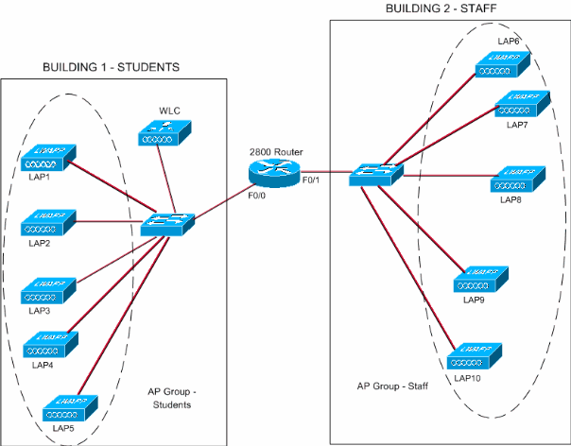
VLAN Example

Slide 10
Wireless Local Area Network (WLAN)
LAN where computers are connected wirelessly
Example:
Washington-Lee’s wifi
Your home’s wifi

Slide 11
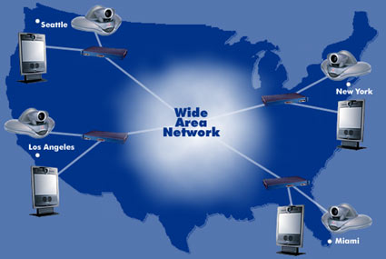
Wide Area Network (WAN)
a really, really big network
your house → ISP → Internet
Washington-Lee → Yorktown → etc.
allows a computer to connect to other computers over a wide geographic area

Slide 12
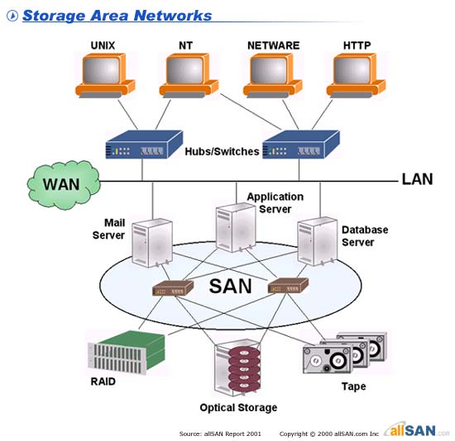
Storage Area Network (SAN)
Network that provides data storage
Examples:
Data centers
Cloud storage

Slide 13
Virtual Private Network (VPN)
Extends a private network across a public network (e.g. Internet)
You create a VPN connection/tunnel from your computer to the private network
Private networks try to remain private, so VPN connections are encrypted
Example:
http://en.wikipedia.org/wiki/File:Virtual_Private_Network_overview.svg

Slide 14
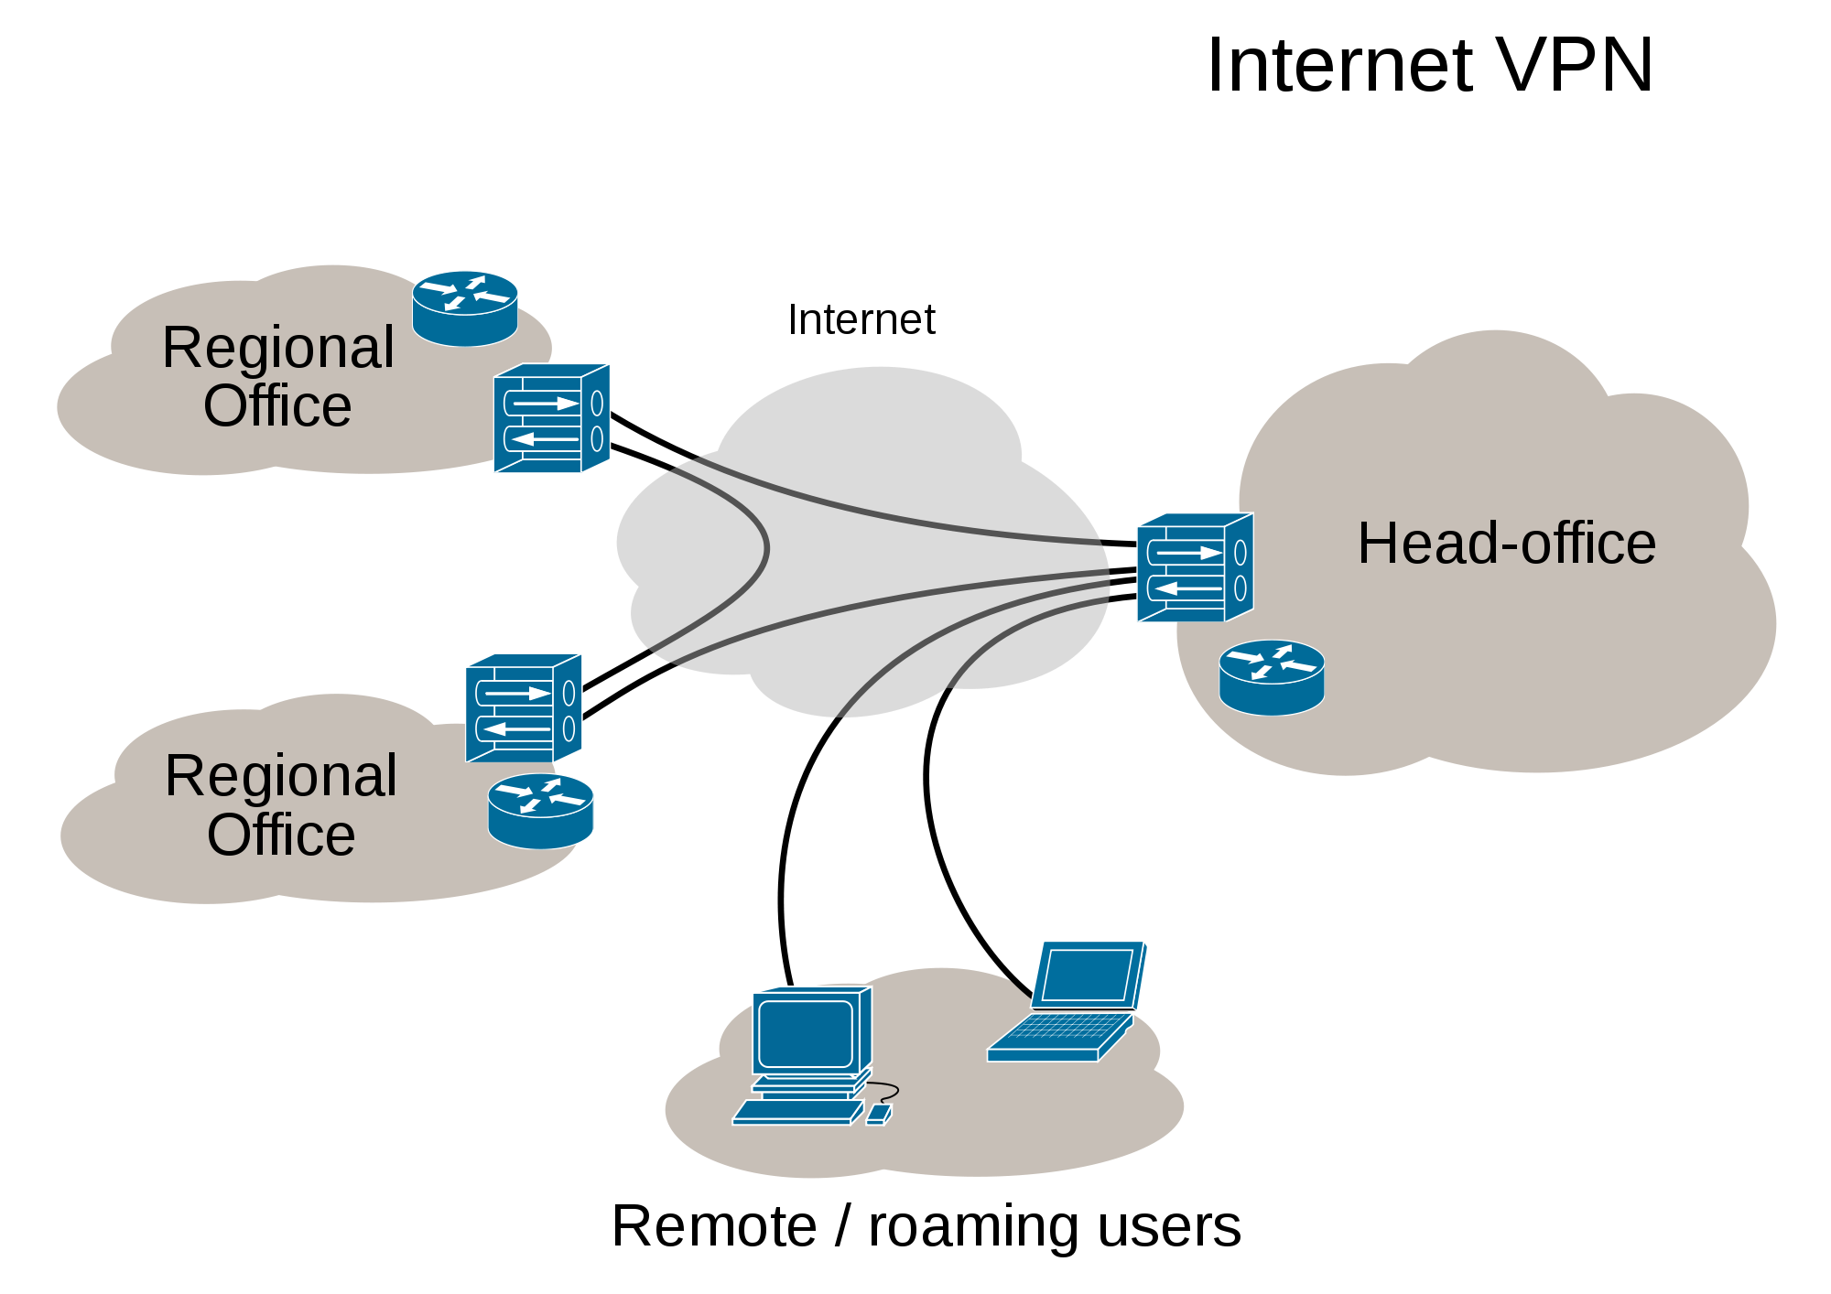
VPN Example

Slide 15
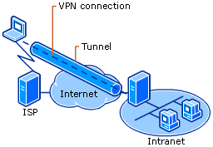
What do you need for a VPN?
Two endpoints
Authentication protocol– verifying the identity of each end point
Connection protocol(s) to connect the two endpoints and create the VPN tunnel
Encryption protocol to secure the tunnel (i.e. Nobody can read the packets in the tunnel)

Slide 16
Evaluate the use of VPNs
Benefits?
Costs?

Slide 17
Personal Area Network (PAN)
Connected devices in an individual’s area
Most popular protocol: Bluetooth
Examples:
Phone <-> speaker
Phone <-> car
Phone <-> earpiece

Slide 18
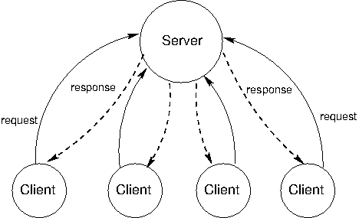
Client-Server Model
Centralized model where clients connect to a server
server
provides services to the network
client
requests actions from a server (i.e. makes requests to a server)
Example:
Websites
Napster

Slide 19
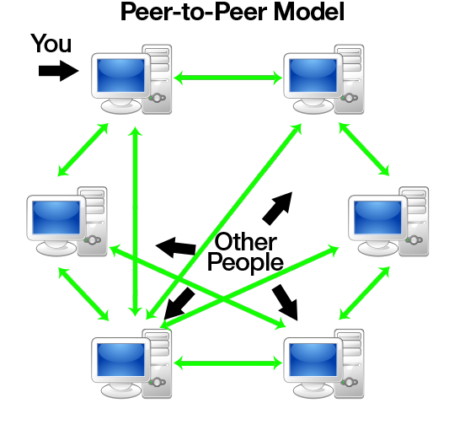
Peer-to-Peer (P2P)
Decentralized
All computers connected act as both clients and servers
Everybody acts as a consumer and a supplier
Example:
Bittorrent

Slide 20
Internet
All computers on the Internet have a unique IP address
Regulated internationally by Internet Assigned Numbers Authority (IANA)
Domain names
Regulated by Internet Corporation for Assigned Names and Numbers (ICANN)
How do you connect to a website on the internet?

Slide 21
Why did the Internet grow so quickly?
Moore’s Law
# of transistors on integrated circuit doubles about every two years
Exponential growth of power
Exponential decay of cost
Examples:
CPUs
Flash drives
Metcalfe’s Law
Usefulness of a network ~ n^2
n(n − 1)/2 → n^2

