Slide 1
Python if-statements

Slide 2
What you know
If something is true, then something happens
Example
If you heat water to 100 degrees Celsius, then it boils
If it rains, then the game is delayed
If I forget to eat, then I will be hungry

Slide 3
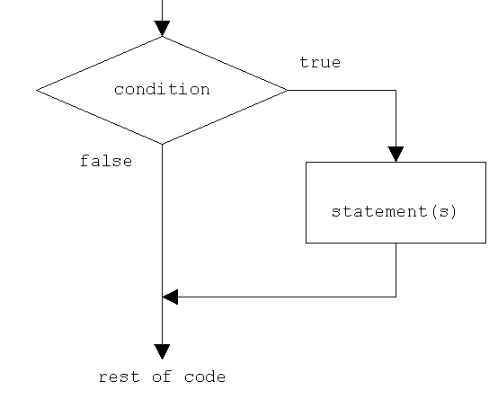
Flow of an if-statement
if

Slide 4
Booleans
Values of True or False
Some expressions simplify/evaluate to Booleans (True/False)
Examples:
5 > 0
10 < 100
If-statement conditions need Booleans

Slide 5
Python If-statement Template
if CONDITION:
#code in if block
#code in if block
What’s happening above?
If the CONDITION is True, then the code in the if block will run

Slide 6
Example
age = int(input(“How old are you?”))
if age > 15:
print(“You allowed to drive”)

Slide 7
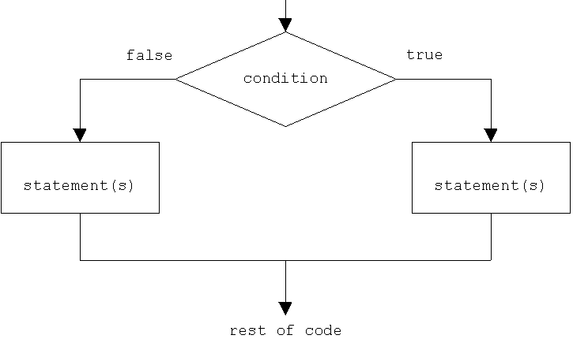
What if I wanted to do something else
if
else

Slide 8
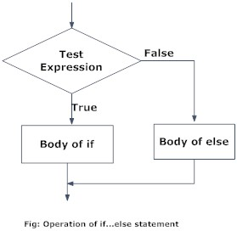
Python if-else statement Template
if CONDITION:
#code in if block
else:
#code in else block
What’s happening above?
If the CONDITION is True, then the code in the if block will run, else, the code in the else block runs
(else runs when the if is False)

Slide 9
Example
age = int(input(“How old are you?”))
if age < 21:
print(“You are not allowed to vote”)
else:
print(“You can vote!”)

