Slide 1
Web Science: AnalyZing the Web

Slide 2
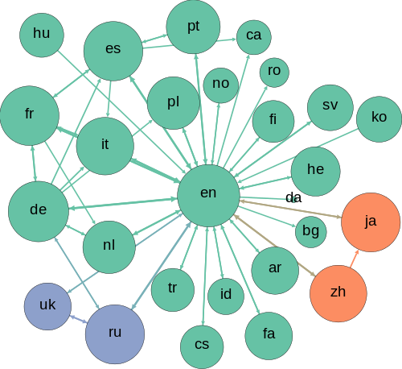
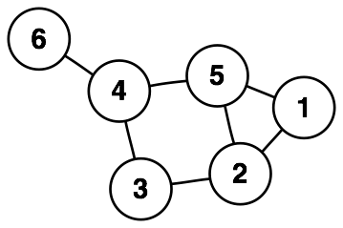
Graph Terminology
Graph ~ a structure of nodes/vertices connected by edges
The edges may be directed or undirected
Distance ~ shortest # of edges connecting 2 vertices
Diameter ~ greatest distance b/w any 2 vertices of a graph
http://en.wikipedia.org/wiki/Graph_(data_structure)

Slide 3
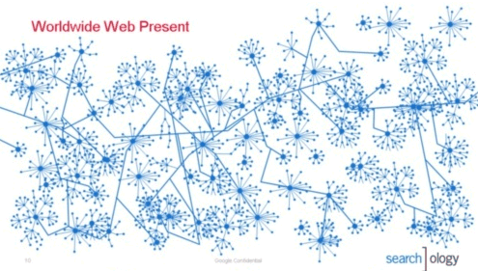
Web graph
Web graph ~ Directed graph that is formed by webpages and their hyperlinks
Sub-graph is a set of pages linked to one specific topic
http://googlesystem.blogspot.com/2007/05/world-wide-web-as-seen-by-google.html

Slide 4
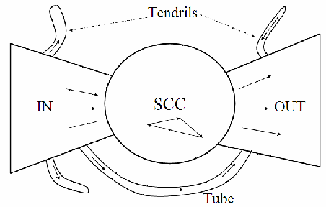
Web graph features
Bow-tie structure of the web graph
IN-links go to a Strongly Connected Core (SCC) of web pages
SCC pages link to all other SCC pages (e.g. paulbui.net/wl)
OUT-links leave the SCC, and you cannot get back

Slide 5
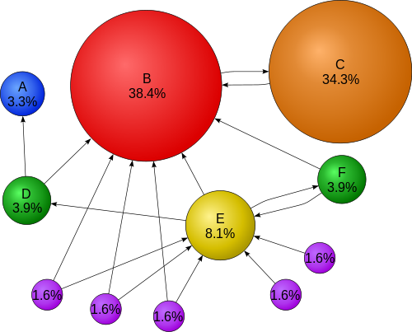
Web Graph Application to PageRank
Google PageRank algorithm used web graphs
http://en.wikipedia.org/wiki/PageRank

Slide 6
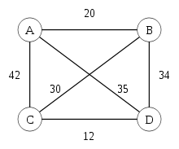
Traveling Salesman Problem (not-IB)
Given a list of cities and the distances between each pair of cities, what is the shortest possible route that visits each city exactly once and returns to the origin city?
http://en.wikipedia.org/wiki/Travelling_salesman_problem

Slide 7
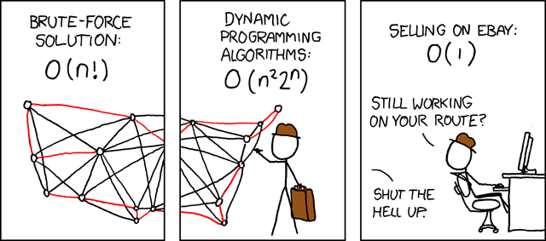
Traveling Salesman Problem cont’d
http://imgs.xkcd.com/comics/travelling_salesman_problem.png

Slide 8
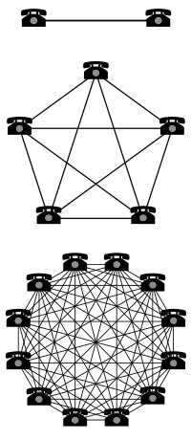
Power laws and web development
Moore’s Law
# of transistors on integrated circuit doubles about every two years
Exponential growth of power
Exponential decay of cost
Examples:
CPUs
Flash drives
Metcalfe’s Law
Usefulness of a network ~ n^2
n(n − 1)/2 → n^2
http://en.wikipedia.org/wiki/Metcalfe's_law

