Slide 1
Web Science: Distributed approaches

Slide 2
Mobile Computing
Laptops
Smartphones
Tablets
And now…
Smartwatches
Fitness trackers
Google Glass (are you a glasshole?)
Any other wearable computing stories?
What are the common features of mobile computing?

Slide 3
Features of Mobile Computing
Wireless access to information
Internet
Cloud services
Etc.
Sensors and other data capture
GPS
Accelerometer
Camera
Wireless communication with other devices
Bluetooth
Near-Field Communication (NFC)

Slide 4
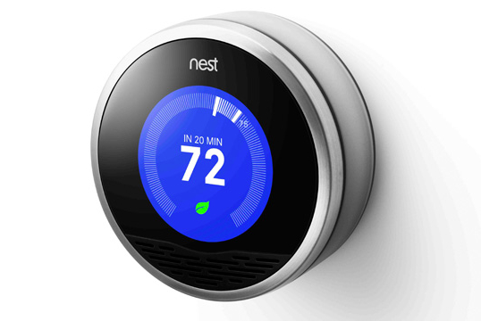
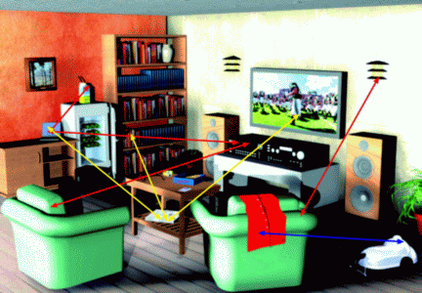
Ubiquitous Computing
The notion that computers are EVERYWHERE and can communicate with each other
Requires sensors and wireless communication

Slide 5
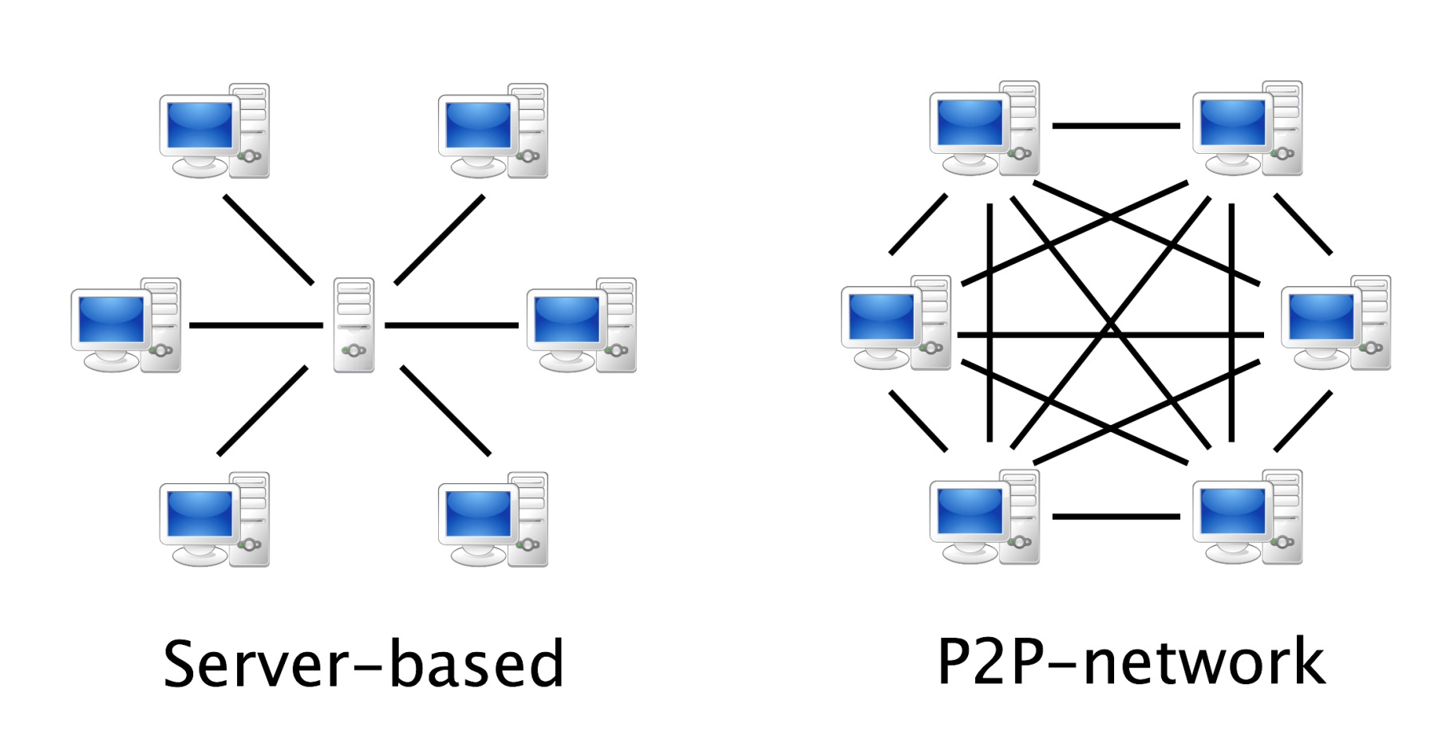
Peer-to-Peer (P2P) Network
Every computer/node/peer in a network is both client and server (e.g. BitTorrent)

Slide 6
Grid Computing
“Grid” comes from the term “electric power grid”
You can plug something into the electrical outlet, and it receives electricity from the electric power grid
Where exactly does the power come from?
Anywhere … you don’t care
Grid computing treats CPU power as a shared, collective resource (like electricity)

Slide 7
Grid Computing Features
Connected computer systems are heterogeneous (different types)
Servers
Networks
Personal computers
Anything!
Connected systems can be geographically anywhere
The grid computer can be used for multiple types of applications
Folding@home (protein folding) - http://folding.stanford.edu/home/
SETI@home (finding aliens) - http://setiathome.ssl.berkeley.edu/

Slide 8
What types of hardware can be used by distributed networks?
Anything and everything

Slide 9
How did we get everything to work together?
Interoperability via open standards
Interoperability – things operate/work with each other
Open standards – publicly usable rules or languages
Web standards examples:
HTML
CSS
JavaScript
HTTP
HTTPS

Slide 10
What is data compression?
Taking data and packaging it to a smaller size (shrink the size of a file)
Examples of data compression:
ZIP (archives multiple files and uses some compression)
JPEG - images
MP3 - audio
H.264 – video (e.g. Blu-ray, YouTube)
Why is data compression used to transmit across a network?
Transfer is faster because the data is smaller

Slide 11
Lossy vs. Lossless Compression
Lossy compression
original quality CANNOT be reconstructed when decompressed (mp3, jpg)
http://upload.wikimedia.org/wikipedia/commons/c/ce/Quality_comparison_jpg_vs_saveforweb.jpg
Loss-less compression
original quality CAN be reconstructed when decompressed (png, flac, zip)

