Slide 1
Patents
Ryan Dickey

Slide 3
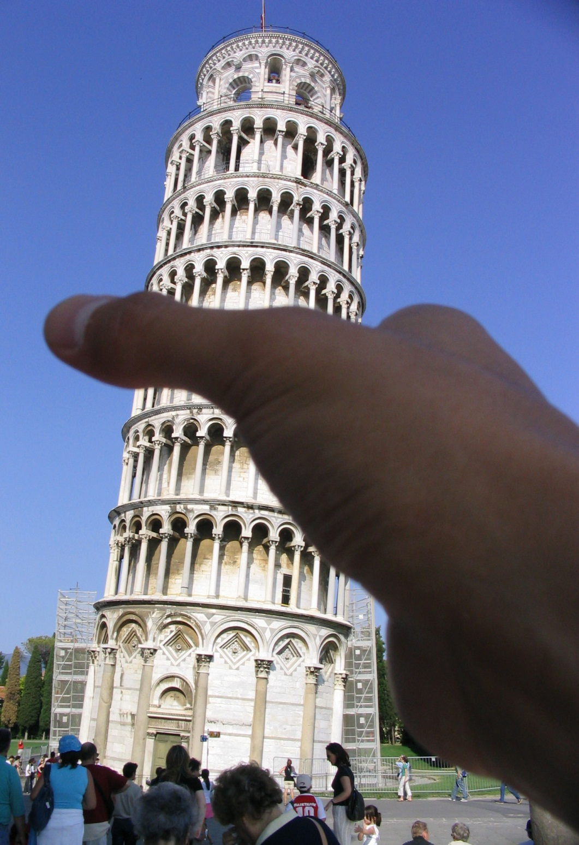

Slide 4
Patent Law

Slide 5
What is a patent?
Congress says:
The right to stop people from
using your invention.
Who can you stop?
“whoever without authority makes, uses, offers to sell, or sells any patented invention.”

Slide 6
Who gets the patent?
Congress says:
The first inventor.
Volunteers?

Slide 7
Big changes to patent process!
Effective March 17, 2013, the U.S. patent system awards a patent to the first inventor to file an application (a.k.a First to file)
First to file is similar to the rest of the world
Why do you think first to file better than first to invent?

Slide 8
Who gets the patent?
For example: malaria vaccine

Slide 9
What if you want to build a new drug?
In 2003:
Average development cost: $802M
Average development time: 7.5 years
(from clinical testing to marketing approval)
Average number of patents: 3.3 patents

Slide 10
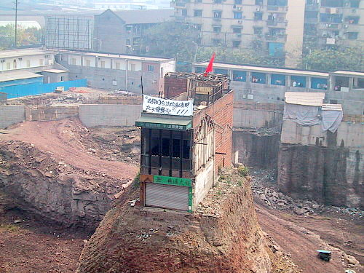
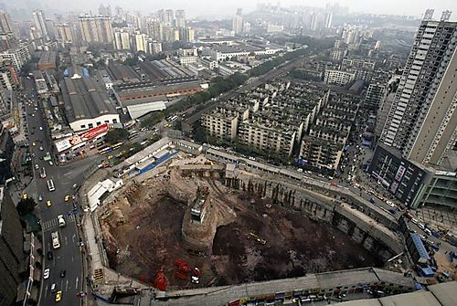

Slide 11
The Constitution
Article I, Clause 8:
The Congress shall have Power . . . .
To promote the Progress of Science and useful Arts, by securing for limited Times to Authors and Inventors the exclusive Right to their respective Writings and Discoveries.

Slide 12
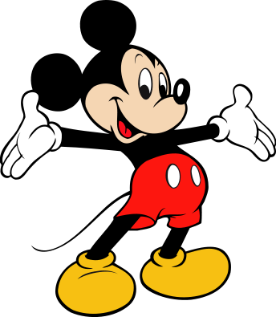
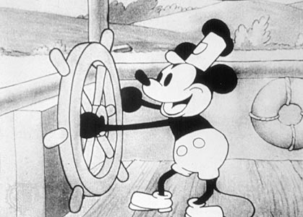
Trademark
Copyright
Trade Secret

Slide 13
What is patentable?
Congress says:
“any new and useful process, machine, manufacture, or composition of matter, or any new and useful improvement”

Slide 14
What is patentable?
Congress says:
“anything under the sun that is made by man”

Slide 15
What is patentable?
What do you say?
(1) Newton’s law of gravity?
(2) Einstein’s E=MC² ?

Slide 16
What is patentable?
What do you say?
(3) A genetically engineered bacterium capable of breaking down crude oil?

Slide 17
What is patentable?
What do you say?
(4) Toupee?

Slide 18
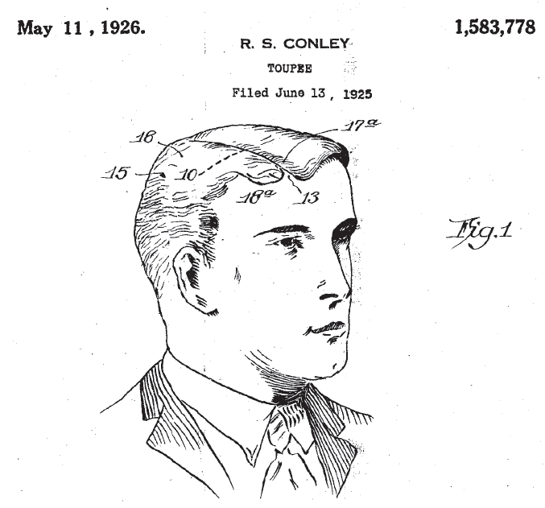

Slide 19
What is patentable?
What do you say?
(5) “Electronic apparatus having game and telephone functions” ?

Slide 20
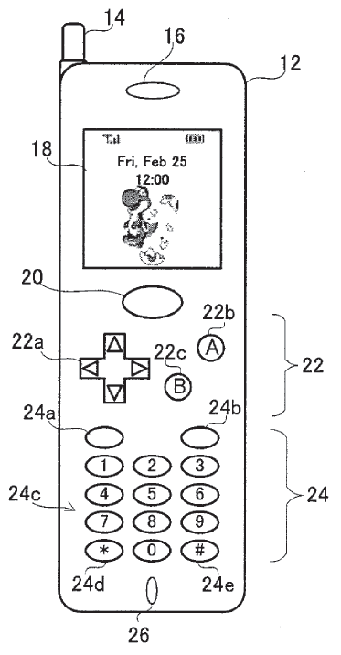

Slide 21
What is patentable?
More requirements:
Novel
Useful
Obvious

Slide 22
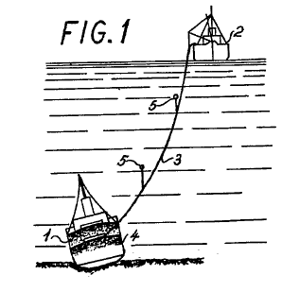
Famous patent case
“The Sunken Ship”
Inventor: Karl Krøyer (Danish)
1960’s
Invention:

Slide 23
Famous patent case
“The Sunken Ship”
Non-infringement
Invalidity

Slide 24
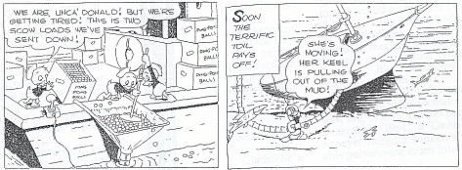
Famous patent case
“The Sunken Ship”
Donald Duck, “The Sunken Yacht” (1949)

Slide 25
Famous patents
Thomas Edison’s light bulb
Alexander Graham Bell’s telephone
Frederic Auguste Bartholdi’s Statue of Liberty

