Slide 1
UML Diagrams

Slide 2
Unified Modeling Language (UML)
Standard “visual language” to graphically illustrate the design of a system

Slide 3
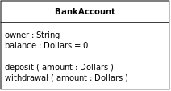
UML Class Diagram Example
Class name
Data members
(attributes)
Methods

Slide 4
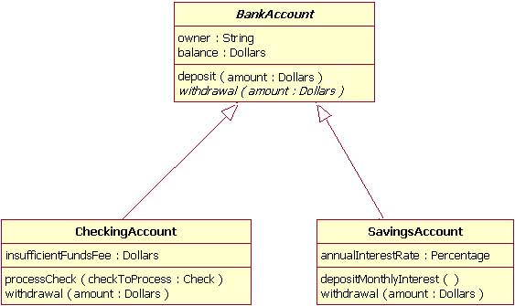
UML Class Diagram w/ Inheritance

Slide 5
Resources
http://www.ibm.com/developerworks/rational/library/content/RationalEdge/sep04/bell/

