Slide 1
Guanjong High School Security Plan
Grace Lundgren, Gavin Obrist, Ronald Fecso, Craig Wanda, Nora Vazbyte, Derek Henderson

Slide 2
Guanjong High School Scenario
The Guanjong High School area is very populated
A “city” school that gives network access to all its students, teachers, administrators, and other staff members
Guanjong is very vulnerable to attacks from outside the school, since it is located in the city

Slide 3
Possible Attacks
Attacks from people in the city
Students being mischievous
System overload with requests/Denial of service attack
New potential viruses and harmful files
Teacher accounts being compromised
Theft of devices

Slide 4
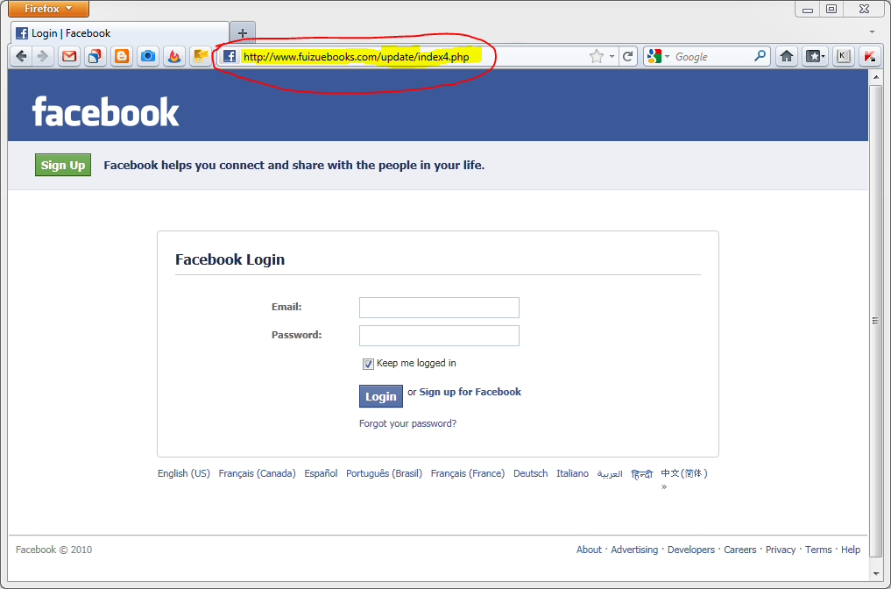
Phishing Attack

Slide 5
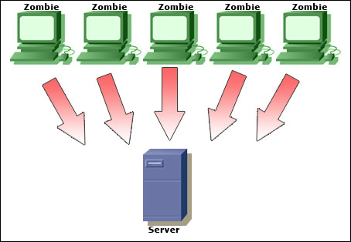
Attack Solutions
Ping attacks
Destroy all pings
Do not allow unverified extensions
Do not allow .exe files
Firewall and antivirus to prevent spyware, malware, viruses
Schoolwide subscription to centralized firewall

Slide 6
New Login Security
Log in with student id and a password
Separate teacher password for Youtube and other blocked websites
Don’t give students and technology-untrained teachers administrative privilege
No access to cmd, Control Panel or system files
Accounts with suspicious activity are suspended
Prevent multiple logins

Slide 7
Network Restrictions
Implement a school-wide filtering system
Restrict unauthorized access to social media, non-productive sites
Can be accessed by teacher log-in
Block all access to known harmful sites
Are not accessible at all to prevent compromised teacher accounts from infecting systems

Slide 8
Access to Network
Register mac addresses to access network
Automatic updates for operating system and useful pre-installed software
Encrypt sensitive data and restrict access
School records kept on intranet, only select computers are connected, connections always monitored

Slide 9
BYOD
Separate network for school authorized computers and outside devices
Guest network password is student ID and password
Non-students/staff members can’t connect using own devices
Can request access in library

Slide 10
Physical Solutions
Lock server cabinets
Encrypt hard drive & network
GPS for laptops, tablets, etc.
Alarm system when people try to take devices from the school
Sends alarm to network administrator when taken past a certain area
Prevent reinstalling OS from external devices
Block booting from external devices

Slide 11
Teacher Solutions
A reporting system where they can report “suspicious” activity
Most teachers are limited in their connection
Education in networks and computers so that they don’t download everything and are suspicious of student files downloaded via e-mail (phishing, scams, keyloggers, etc.)

Slide 12
Student Solutions
Have clear guidelines for students to follow
Training sessions on appropriate web conduct
School web rules posted in computer labs
Set up strict rules and consequences for breaking them
Allow students to easily report suspicious activity
General student education

