Slide 1
XXXSecurity Website
By: Talbia, Derrick, Christos, Andrew, Angel

Slide 2
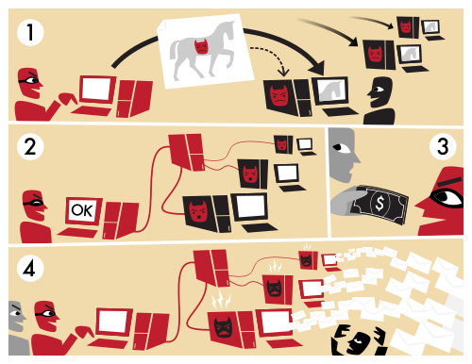
Distributed Denial of Service (DDoS)
Flood of HTTP requests
Botnets
Filter incoming packets
MyDoom worm

Slide 3
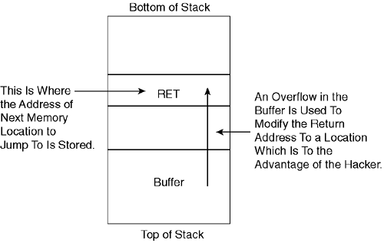
Stack-based Buffer Overflow
Buffer receives more data than it has space for
Overflows onto adjacent stacks
Executable code used to control computer
Prevention:
Stack canaries
Input Validation

Slide 4
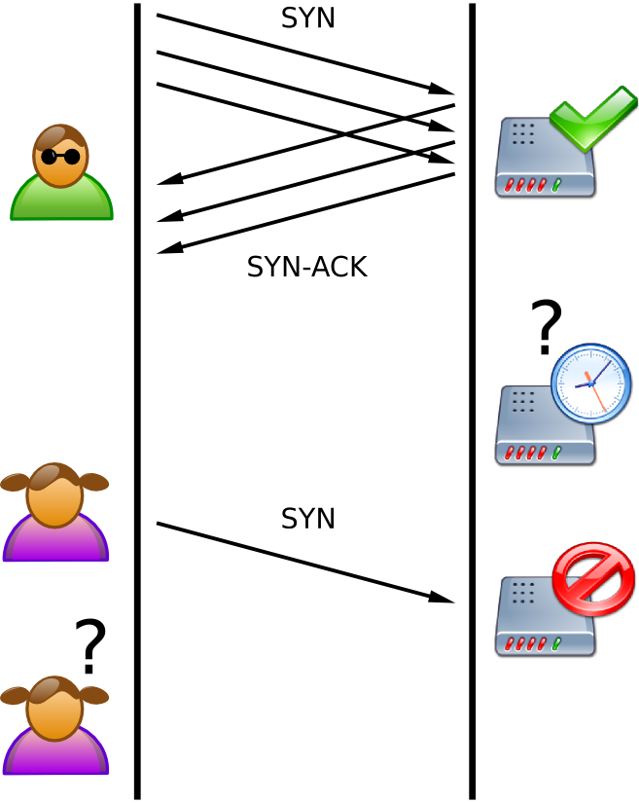
SYN Flood
SYN - a message trying to open a connection
Countermeasures
Filtering
Increasing Backlog
Reducing SYN-RECEIVED
Recycling Oldest Half-Open TCB
SYN Cache
SYN Cookies

Slide 5
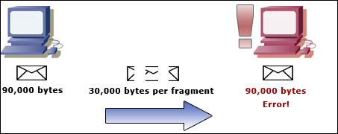
Ping of Death
Sending a massive ping to crash a computer
Average ping size 56 bytes
Ping of Death size 65,356 bytes
Causes Buffer Overflow to victim
Can also be sent in smaller fragments
Prevention:
Ignoring pings larger than 65,356 bytes
Increasing memory buffer, to larger than 65,356 bytes

Slide 6
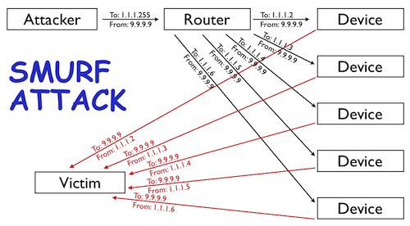
Smurf Attacks
Packets from spoof IP address of victim
Hosts send response to broadcast
Too many responses → victim’s server slows down
Ingress filtering

Slide 7
Teardrop Attacks
Sending mangled, oversized packets in an attempt to crash the computer
Not very effective today due to security improvements

