Slide 1
Company Website
-DOS Attacks
By: Alex, Alexandre, Kevin, Matt N., Michael, and Zach

Slide 2
General Description
Deny service to client by manipulating packets and the way packets travel to either prevent the server or the client from connecting to each other
Notes:
Alex

Slide 3
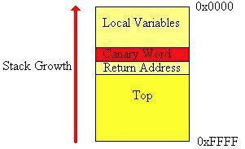
Stack-Based Buffer Overflow
Program writes to a memory address on the program’s call stack outside of the intended data structure, which is usually a fixed length buffer
Results in corruption of data on adjacent stack
Prevention
Detect that an attack has occurred and prevent program redirection
Prevent execution of malicious code in stack without directly detecting that a stack buffer overflow has occurred
Randomize memory space of a program
Notes:
Michael

Slide 4
Application-level Floods
Buffer overflow to use up victim’s resources, i.e. disk space, bandwidth, and memory
Prevention
Detect that an attack has occurred and prevent malicious code
Prevent execution of malicious code in stack without detecting attack
Randomize memory space such that it is difficult to find the executable code for current program
Notes:
Matt

Slide 5
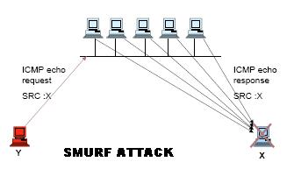
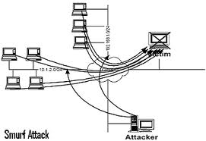
Smurf Attack
Lots of ICMP packets with victim’s spoofed source IP are broadcast to a computer network
Devices being attacked will reply to the source IP address which floods the target’s computer with traffic
Prevention
Turn off the forwarding of directed broadcast on all router ports
Notes:
Alexandre

Slide 6
Nuke
Modifies pings to send corrupt, malicious data, attacks computer by disguising itself as a ping
WinNuke -> Blue Screen of Death
Prevention
monitor ping transfers and ports
Notes:
Matt

Slide 7
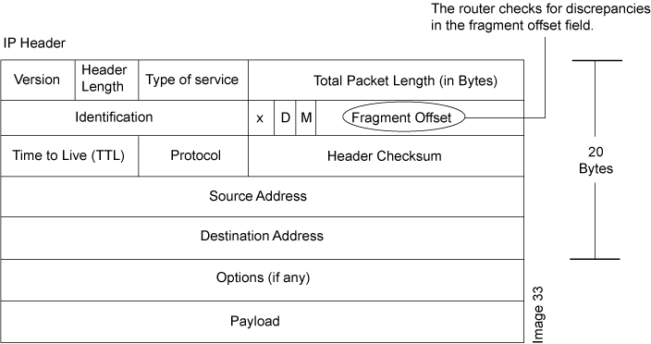
Teardrop attack
Mangled IP fragments of overlapping, over-sized payloads sent to the target
Causes crashes due to a bug in TCP/IP fragmentation reassembly code
Prevention
use updated/newer computers (they don’t have the same bug in their reassembly code)
Notes:
Zach

Slide 8
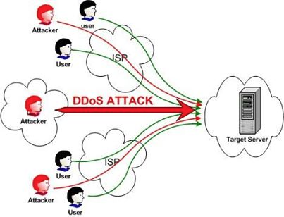
Distributed Denial-of-Service Attack (DDoS)
Multiple systems innundate server with connections which slows it down
Has to respond to all of the junk requests which prevents it from handling legitimate requests
Prevention
Whitelist so hacker machines cannot connect as easily
Notes:
Kevin

Slide 9
Permanent Denial-of-Service Attack
Exploits security flaws to replace the system’s firmware with a malicious firmware image (copy)
Renders device useless to the owner until repaired or replaced
Also known as phlasing
Prevention
Limit network connectivity of devices on a network to their specific function
Use PhlashDance (HP) to detect flaws
Notes:
Zach

Slide 10
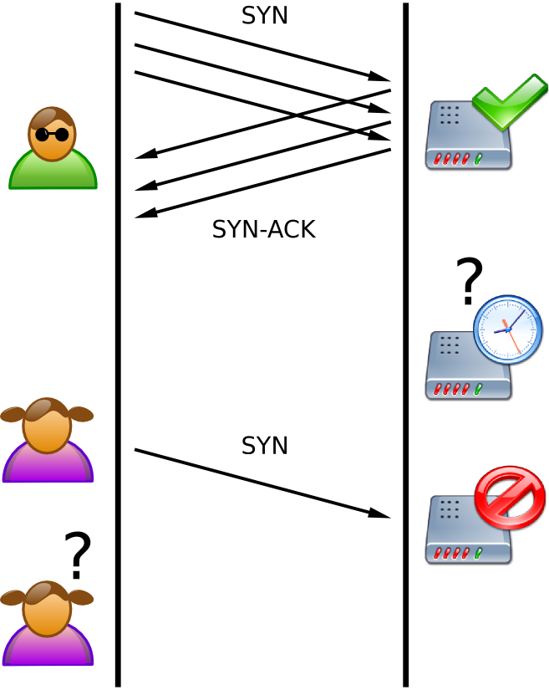
SYN Flood
Client and server try to establish TCP (synchronize, acknowledge, acknowledge)
Client doesn’t respond - makes the server wait for response -> increases response time
Many computers doing this at once creates a flood of hanging requests
Prevention:
Make the server not wait for more than 20 ms for an acknowledgement
Notes:
Alex

Slide 11
Banana Attack
An attacker redirects all outgoing packets back to the sender which limits outside access and inundates them with packets
Prevention
Monitor source address to make sure it’s different from your own
If detected, block packets from your own IP
Notes:
Alex

Slide 12
Slow Read Attack
Attacks server so that valid applications requests are read and processed by the server slowly
Achieved by decreasing server’s TCP Receive Window Size and by emptying client’s TCP receive buffer slowly
Prevention
Do not accept packets that advertise a small Window size
Limit the absolute connect time to a reasonable value
Notes:
Alexandre

Slide 13
Ping Flood
Attacker overwhelms victim with ping packets as fast as possible without waiting for replies
Prevention
Restrict the number of pings from a computer and/or prevent pings from outside the network
Notes:
Zach

Slide 14
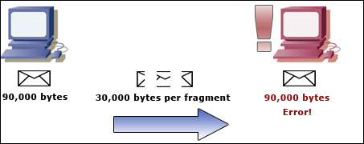
Ping of Death
Most computers cannot handle ping packets bigger than 65,536 bytes or 64 KB
Because this now violates the Internet Protocol, attackers fragment the ping so that when it reassembles it causes a buffer overflow and crashes the computer
Prevention
Limit ping packet size and
monitor ping traffic
Notes:
Kevin

Slide 15
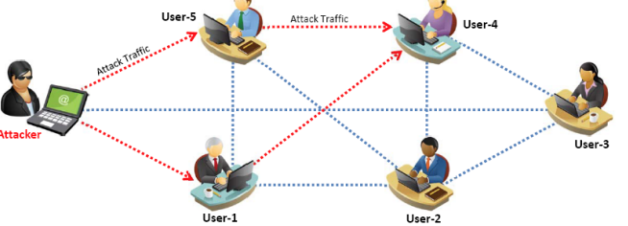
Peer-to-Peer Attack
Attacker acts as “puppet master,” instructing clients of large peer-to-peer file sharing hubs to disconnect from their peer-to-peer network and connect to the victim’s website instead
As a result, several thousand computers may aggressively try to connect to a target website
Prevention
Only allow client-server connections and not P2P connections
In peer-to-peer protocol, limit connection to port 80 while on the peer-to-peer network, which handles HTTP requests
Notes:
Michael

Slide 16
R-U-Dead-Yet? (RUDY)
An attack that continuously injects data into an application POST field which forces the application to wait for the never-ending POSTs to end in order to perform processing
Prevention
Limit individual IPs to a max amount of POSTs per minute
Notes:
Alexandre

