Slide 1
Guanjong High School
Group 2

Slide 2
Physical Network Access Security
Getting into a network closet could easily allow someone to disable computers and connect their own device to the network.
By having simple but secure access to the closet, this could easily be avoided.
Plan:
Door with key lock
Security camera
Notes:
Physical attacks getting into network directly
Packet injection
Plug in
Man middle

Slide 3
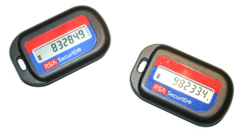
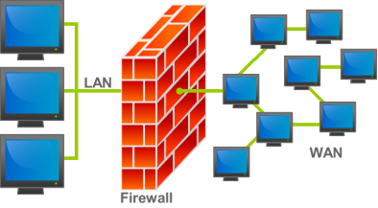
Network Attacks from outside users
Have an unsecure network could cause attacks from the outside world.
Implementing security measures would increase the safety to the network.
Plan:
Add Whitelist
Add Firewall protections
Notes:
Adding a Whitelist to the network would keep outsiders away from the network. The only way to access it would be if the device was pre-registered. Each teacher can register up to 3 computers for remote access.
Firewall protections would stop attacks from whitelist users. Should a whitelist user become infected, the firewall would block traffic if it sees unusual protocol requests or unusually high traffic.

Slide 4
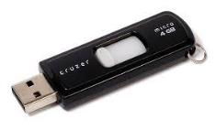
Bring your own device attack/LAN Connected Computer Infection
Allowing people to download/install software onto a school computer would increase the vulnerability of the network.
Adding accounts and restrictions on school computers would boost the networks security.
Plan:
Student Accounts (Student Accountability)
Teacher/Administrator Password
Infection Detection (Virus/Malware Scanner)
Notes:
Add students accounts so there will be student accountability
An admin password will be required to install/download programs on the school computers
If a student computer becomes infected, the network will recognize unusual traffic volumes and types coming from the infected computer, the computer itself could then be located and stifled.

Slide 5
Browser Based Attacks
Different levels of security are needed to ensure that malicious programs are not downloaded
Plan:
Level 1: Teacher Accounts
Level 2: Student Accounts
Level 3: Guest Accounts
Notes:
Guest accounts: Delete all files downloaded during the session from the computer. Restore the account to prior to logging in
School accounts: Can download files but the history is tracked and unclearable by student. Students cannot download any executable files.
Teacher accounts: Can download files but history is also tracked and unclearable. Teachers may download executable files.
Network Administrator that can access anything.
Prevent worms, trojans and malware from being protected

Slide 6
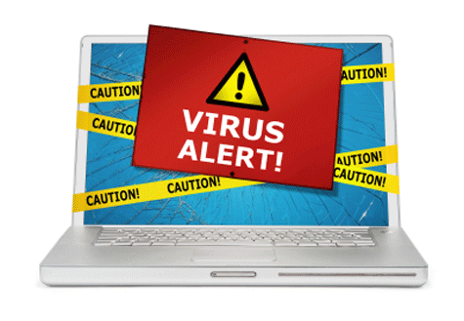
Isolation
Isolate an infected computer
Block IP
Based on high levels of or suspicious outgoing traffic
Prevents viruses from spreading to other computers

