Slide 1
Bring Your Own Device (BYOD)
JT, Ahad, Rob, Patrick, Temuulen, Jacob

Slide 2
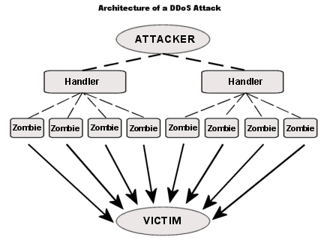
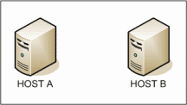
Denial-of-service attack
How to prevent it:
use of SYN cookies which may be used to limit any overflow of traffic from a certain TCP/IP address
Packet filtering
Blacklist certain IP’s
Notes:
What it is: an attempt to make a network or server unavailable by spamming it with requests so that response time increases

Slide 3
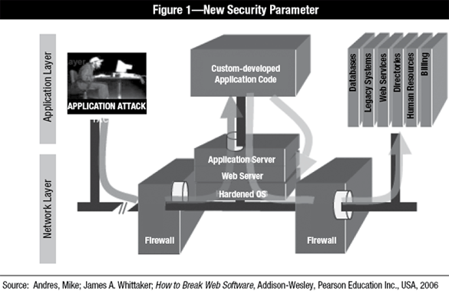
Application Layer Attack
Attacks the application layer (web server, web application, etc) by overloading requests
How to prevent: Distinguish human traffic from bot traffic to detect attacks (monitor for unusual traffic)

Slide 4
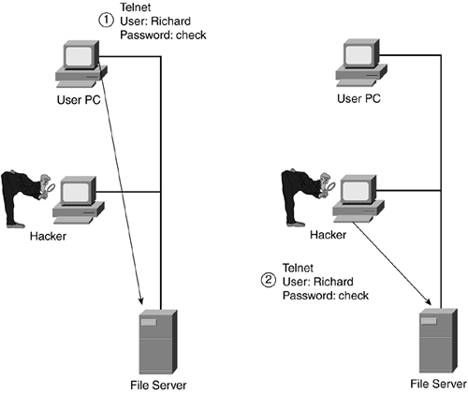
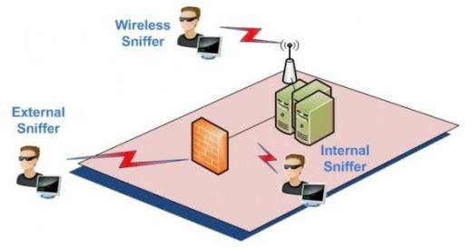
Sniffer Attack
A sniffer attack is the process of listening to or the interception of data being transferred on a network.
How to prevent: Encryption or Secure Protocols.

Slide 5
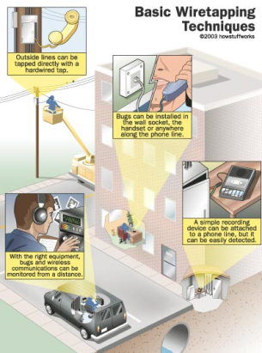
Wiretapping
How to prevent it:
Company wide VPN
Promoting use of Tor at home for work
“Sweeps” for bugs
Notes:
The monitoring of telephone and Internet conversations by a third party, either passive by monitoring or recording the communication or active by altering it

Slide 6
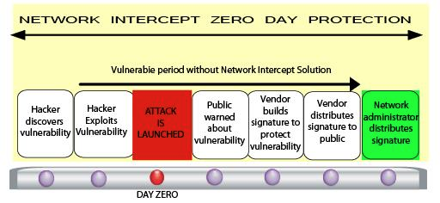
Exploit/Zero-Day Attack
Exploits a previously unknown vulnerability
How to prevent it:
Block old exploitation techniques
Notes:
The name comes from the literal meaning that the attack is discovered on "day zero" of awareness of the vulnerability, which is known to the public for a period of 0 days.
By blocking an exploitation technique, we are breaking the chain, i.e., the sequence of events that must occur for the exploit to succeed. This means that the entire attack is blocked. Therefore, blocking all exploitation techniques will prevent every exploit from succeeding. At the moment of the blocking, we are able to take a “real-time picture” of the memory, which provides invaluable information about the prevented attack.
https://cyvera.com/solution/zero-day-attacks/

Slide 7
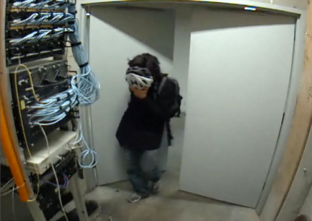
Close-In Attack
A close-in attack involves someone attempting to get physically close to network components
How to prevent it:
Limit movement through critical network areas
Track the source of the attack
Notes:
use this for explanation -> http://computernetworkingnotes.com/network-security-access-lists-standards-and-extended/types-of-attack.html

Slide 8
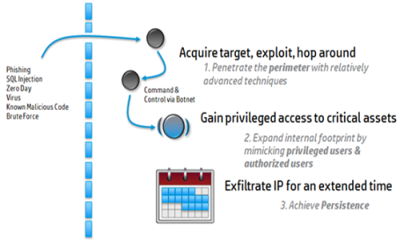
Insider Attack
How to prevent it:
Disable removable devices
Encrypt data on portable devices
Segregate your network
Keep your employees happy

Slide 9
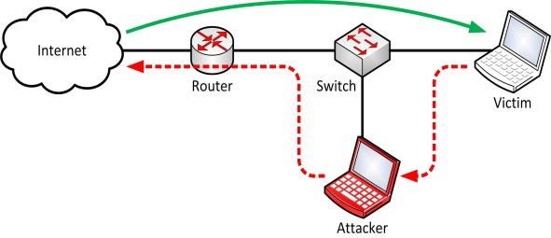
Data Modification
How to prevent it: encrypting data or creating a vpn to disallow outside attacks
Notes:
What it is: Once an attacker has read your data, he has the ability to alter the data within.

Slide 10
Policies
Wi-Fi - Receive the WPA-2 key from us, do not share it
Wired - All wired connections will be through the company’s VPN
Be sure to keep your RFID tag with you at all times
Don’t mix personal and work account information

