Slide 1
Control Systems

Slide 2
Example control systems
Automatic doors
Heating systems
Taxi meters
Elevators
Washing machines
Domestic robots (e.g. Roomba)
GPS systems,
Traffic lights
Process control (automation in factories)

Slide 3
Typical control system (feedback loop)
+/- (sum function) is calculated by a microprocessor
Controller or microcontroller is programmed to tell the system how to react
Transducer – converts one form of energy to another; a sensor is a type of transducer

Slide 4
What sensors would be used in the scenarios below?
Automatic doors
Heating systems
Taxi meters
Elevators
Washing machines
Domestic robots (e.g. Roomba)
GPS systems,
Traffic lights
Process control (automation in factories)

Slide 5
Central vs. Distributed control system
Sensors and controllers are distributed throughout a system instead of centralized
The system must monitor and control multiple distributed equipment/hardware
Example:
Factories with multiple stations in assembly lines
Traffic signals (multiple working together)
Sensor networks

Slide 6
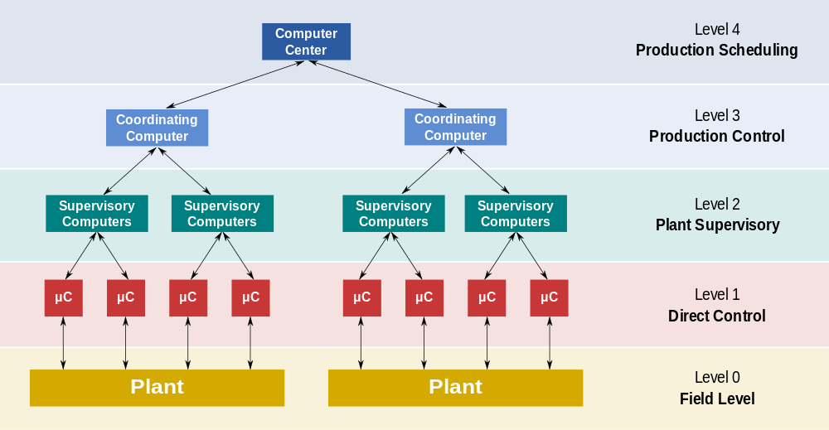
Distributed Control System
http://en.wikipedia.org/wiki/Distributed_control_system

Slide 7
Autonomous Agents
Autonomous ~ free from control
An autonomous agent is intelligent enough to work on its own without interference from a controlling entity
In a larger system, the autonomous agent works by itself, but may pass information somewhere (for coordination)
Examples:
Self-driving cars
Self-propagating computer viruses (worms)

