Slide 1
IBCS Case Study - Western Heights Security Plan
Defending Against Advanced Persistent Threats

Slide 2
Security Goals
Prevent outsiders from looking in
Prevent outsiders from changing information
Keep client information secure

Slide 3
Advanced Persistent Threats
Long term threat from a group of hackers
May use many methods to access backdoor and access data
may tap phones, phishing schemes to get things like logon info, use port scanning
usually don’t steal info and run-- they want long term access
Notes:
- Threat from a group of hackers trying to get information-- not unintelligent computers. They are often skilled.
- People can use non-computer techniques to intrude-- (i.e. tapping a phone).
-Also may use social engineering (like phishing) to get access to a “backdoor”.
-large and unexpected flows of data, especially outbound data, to see theft is taking place
-Persistent - usually the attack is “low and slow” and long term access is the goal.

Slide 4
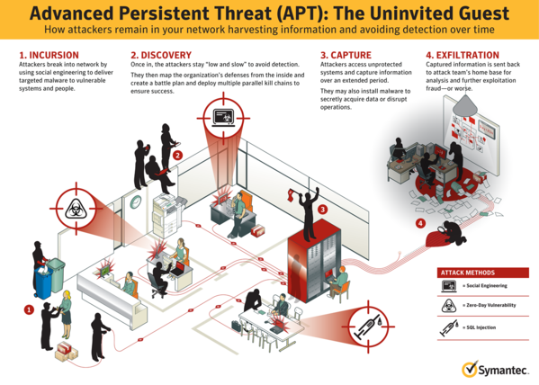

Slide 5
Protecting against APTs
Must have:
defense plan
including anti-virus programs, teaching employees to stay away from phishing attacks
ability to see when something goes wrong
response plan when something goes wrong
learn something from it

Slide 6
Dealing with APTs
IPS monitors for malicious activity, then blocks it when it happens
For example, can block traffic from a given IP address if there are large and unexpected flows of data (esp. outbound)
network forensics
stores network traffic reports-- good for investigating
Stop back doors
detect and remove Remote Access Trojans & other malware

Slide 7
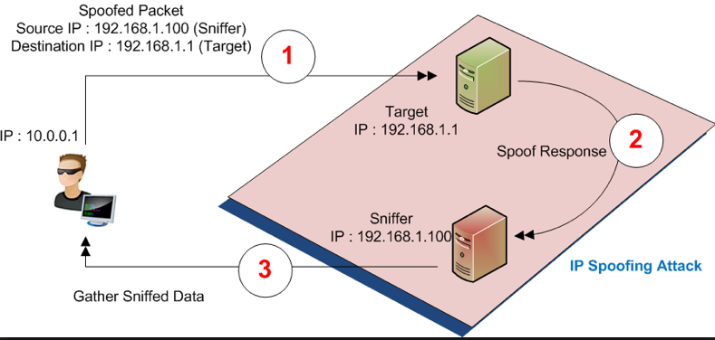
Threat #2: Sniffer Attacks/Spoofing
What is it:
How to Prevent it:
-A switched network
-Full encryption of the data
-Antisniff that scan networks to determine if any NICs (Network Interface Cards) are running in promiscuous mode.
-Regular use of all detection tools

Slide 8
Threat #3: Denial of Service (DoS)
What it is: An attempt to make a machine or network resource unavailable for users to access.
Why it’s used: It is vital for the website of a pharmaceutical company to be accessible to customers in order to obtain information of particular products and latest news of the company. If the consumer or distributor are not able to access this information it can be a problem for health is an essential service.

Slide 9
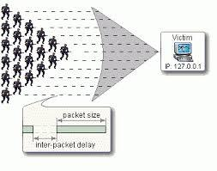
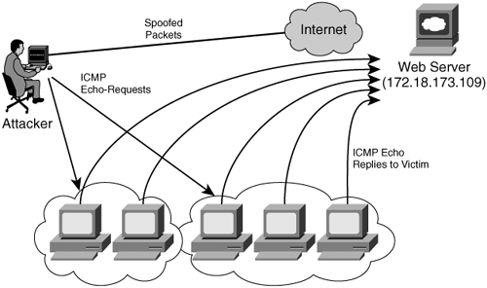
Threat #3: Denial of Service (DoS)
PING Flood
Smurf Attack
The attacker sends these ICMP datagrams to addresses of remote LANs broadcast addresses, using so-called directed broadcast addresses. These datagrams are thus broadcast out on the LANs by the connected router.
turn off the forwarding of directed broadcast on all router ports or take other measures to assure your network cannot be abused in this manner.
Ban external pings

Slide 10
Threat #3: Denial of Service (DoS)
There are multiple ways of combating DoS attacks:
Firewall
Setup rules to allow or deny protocols, ports, or IP addresses
Switches
Provides automatic and system wide rate limiting, traffic shaping, delayed binding, deep packet inspection and IP filtering
Blackholing
All traffic is sent to a “black hole” (a non-existing server)
Clean Pipes
Traffic is passed through a cleaning center through various methods such as proxies, tunnels or even direct circuits which separates bad traffic and only sends good traffic through

Slide 11
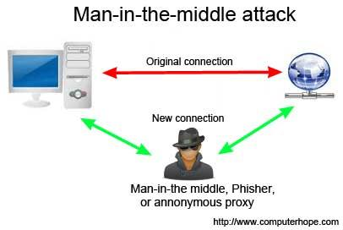
Threat #4: Man-in-the-middle
What it is: Occurs when someone between two communicating users is actively monitoring, capturing, and controlling the communication. This can lead to stolen information (credit card info, social security, etc.) and the altering of packets.
Prevention: HTTPS and VPNs; both use encryption to secure data.

Slide 12
Threat #5: XSS Attack
What it is: The attacker exploits the XSS vulnerabilities found in Web Server applications in order to inject a client-side script onto the webpage that can either point the user to a malicious website of the attacker or allow attacker to steal the user's session cookie.
How to Prevent it: Strict rules.
1)The first rule is to never put untrusted data in the HTML script, except in allowed, protected locations.
2)Encoded data that is prevented from executable content must be used.
3)Escape all data with an ASCII value of less than 256 so that they cannot be switched out of the attribute.
These rules ensure the Western Heights website will be safe from harmful change to the existing framework.

Slide 13
Threat #6: Buffer Overflow Attack
the victim host is provided with traffic or data that is out of their processing power
the excess data is stored in adjacent buffers, overwriting data that could contain malicious code
includes getting backdoor access and crashing systems
limit incoming traffic using existing structures or proposed solutions
canaries - values that are placed between a buffer and control data on the stack; first to fail if attack present

Slide 14
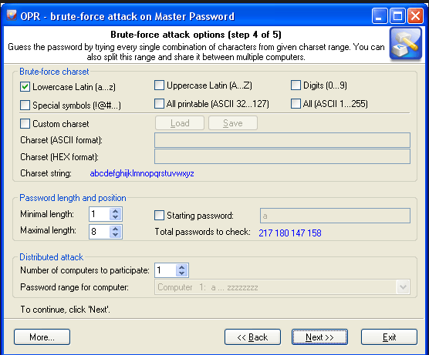
Threat #7: Password Attack
What it is: Maliciously determining user passwords to control their account and access private information, such as credit card numbers.
How to Prevent it: Clear password policy for clients and mandatory password changing.

Slide 15
Threat #8: SYN Flood
Denial-of-service attack in which an attacker sends a succession of SYN requests to a target's system
attempts to make the system unresponsive to legitimate traffic
Solution: impose limits on the number of SYN segments that can pass through the firewall per second
Filtering
Increasing Backlog

Slide 16
Existing Security Structures
Proxy Servers: servers that acts as an intermediary for requests from clients seeking resources from other servers
Intrusion Detection System: software or product that monitors network or system activities for malicious activities or policy violations and produces reports to a management station; not always required to stop threats
Intrusion Prevention System: appliance that monitors network and/or system activities for malicious activity; may attempt to block or prevent threats
Security Information and Event Management System: software or device that provides real-time analysis of security alerts generated by network hardware and applications

