Slide 1
Networks – Data Transmission

Slide 2
Vocabulary Review
Protocol
Agreed set of rules
Data packet
Envelope of data sent across a network
Contains
Source address
Destination address
Sequence #
Timestamp
Data itself
And more!

Slide 3
Why does data transmission speed vary?
Download and upload speed/bandwidth of the client
Download and upload speed/bandwidth of the server
Amount of traffic across the network
Your local network
The ISP’s network
The Internet itself
Demand for the network or web resource
It takes longer to access something that is being accessed by everybody

Slide 4
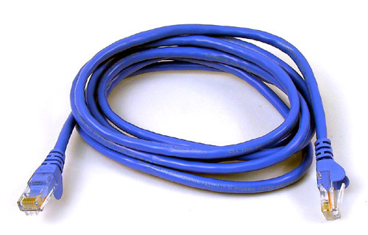
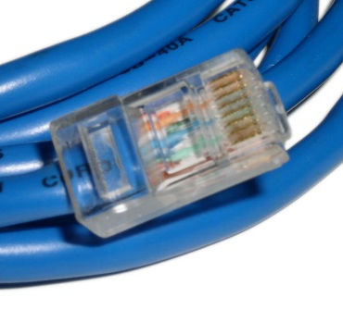
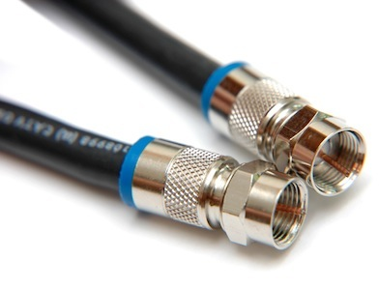
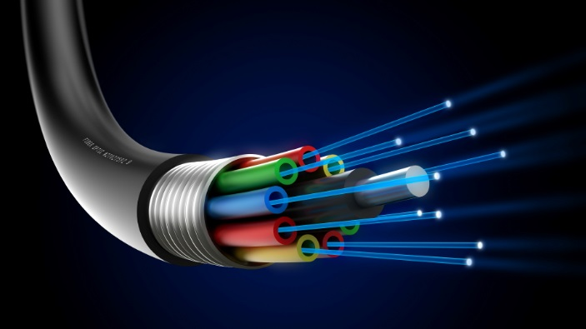
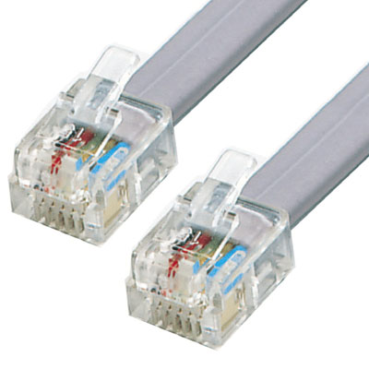
Transmission Media/Medium
Metal conductors
Ethernet cables
Coaxial cables
Phone lines
Fiber optics
Made from glass or plastic
Example: FIOS
Wireless (i.e. radio waves)

Slide 5
Transmission Media Characteristics
Speed
Reliability
Cost
Security
Evaluate each of the transmission medias.

Slide 6
Transmission Media/Medium
Medium | Speed | Reliability | Cost | Security
Metal Conductors | Fast | Good | Most expensive | OK
Fiber Optics | Fastest | Good | Cheapest cable, but more expensive equipment | OK
Wireless | Slower b/c of noise and interference | Not as good because of noise, distance, and interference | Air is free | Encryption and password necessary to secure network

Slide 7
What is data compression?
Taking data and packaging it to a smaller size
Examples of data compression:
ZIP (archives multiple files and uses some compression)
JPEG - images
MP3 - audio
H.264 – video (e.g. Blu-ray, YouTube)

Slide 8
Why is data compression used to transmit across a network?
Compress / shrink the size of a file
Transfer is faster because the data is smaller

Slide 9
Lossy vs. Lossless Compression
Lossy compression
original quality CANNOT be reconstructed when decompressed (mp3, jpg)
http://upload.wikimedia.org/wikipedia/commons/c/ce/Quality_comparison_jpg_vs_saveforweb.jpg
Loss-less compression
original quality CAN be reconstructed when decompressed (png, flac, zip)

