Slide 1
Western Heights Pharmaceuticals
Connor, Marquise, Carolyn, Christian, Quinn

Slide 2
Generic Security
Malware detection software.
Use proxy servers for remote access.
Physical Security
Lock access to the server.
Prevent non-admin accounts from running executable files.
Block social networking websites.

Slide 3
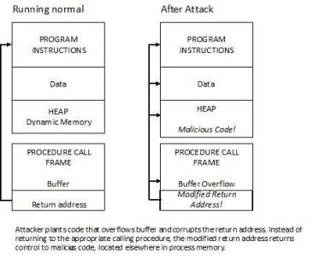
Buffer Overflow
A buffer overflow is an anomaly where a program, while writing data to a buffer, overruns the buffer’s boundary and overwrites adjacent memory. This causes a crash, a breach in system security, and/or incorrect results.

Slide 4
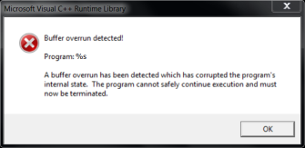
Buffer Overflow
Some ways to prevent a Buffer Overflow:
Choice of programming language - Some different programming languages provide a runtime checking which might send a warning or raise an exception.
Use of safe libraries - Are well-written and tested abstract data type libraries which centralize and automatically perform buffer management. Two main data types are arrays and strings.
Buffer overflow protection - It checks that the stack has not been altered when a function returns. If it is altered, the program exits with a segmentation fault.
Executable Space Protection - is an approach to buffer overflow protection which prevents execution of code on the stack or the heap

Slide 5
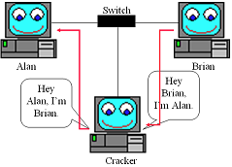
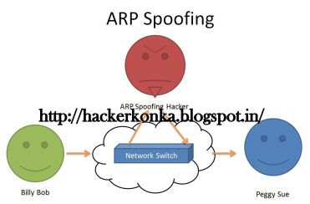
ARP Spoofing
Brief summary:
is when an attacker sends fake Address Resolution Protocol (ARP) messages onto a LAN.
Generally used to give themselves another host IP address causing whatever traffic meant for that IP address to be sent to the attackers instead.
Possible solutions:
Static ARP entries
ARP spoofing detection software
Os security
Notes:
Legitimate usage for to implement redundancy of network services

Slide 6
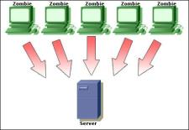
Ping Flood
A DOS attack where the server is overwhelmed by a large number of ICMP echo request packets, also known as pings. The server slows down and takes a long time to handle legitimate requests.
Solutions:
Configure your firewall to disallow pings
Block the attacker’s IP address from accessing your network

Slide 7
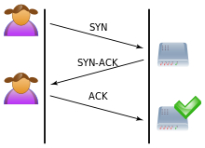
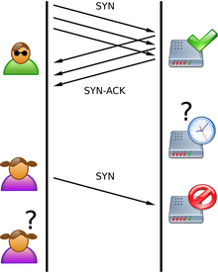
SYN Flood
A DOS attack where several SYN (synchronization) packets are sent to the server without a follow-up ACK (acknowledgement). The server occupies time waiting for verification that never arrives.
Solutions:
Limit the number of SYN requests per second by firewall.
Reduce timer (don’t wait as long for ACK).
SYN cookies: compress the SYN queue entry (on the server) which can then be restored upon receiving the ACK packet.

Slide 8
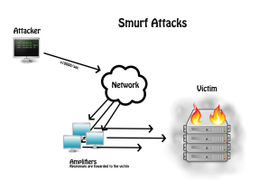
Smurf Attacks
Definition: A denial-of-service attack in which large numbers of Internet Control Message Protocol (ICMP) packets with the intended victim's spoofed source IP are broadcast to a computer network using an IP Broadcast address.
Solutions
Turn off broadcasting address feature on routers.
Configure server operating systems not to respond to direct broadcast requests.
Use firewall to block ICMP packets on victim's computer (damage control).

